Slide 1
Field tests log_009 → log_011
Team B3
From a manual drive run to a teach-and-repeat route follower
Case Study Cooperative and Autonomous Systems · THD · October 2026
Notes:
Three logs, three steps. log_009 gave us a clean reference route. log_010 tested the first autonomous mission and showed GPS cannot be the primary guide. log_011 tested the segment follower and revealed how the rover physically turns.

Slide 2
Logs
OVERVIEW
log_009
log_010
Manual teaching run B → H
Mission: wall B → GPS to H
Full manual drive recorded as the reference route
Wall following along B, then GPS waypoints towards H
Result: made the benchmark; 22 waypoints extracted.
Result: wall leg worked; GPS legs were 6–15 m off.
2 · Overview
Notes:
Each log built on the one before and set up the next test. The deck follows that chain: approach, decision, outcome.

Slide 3
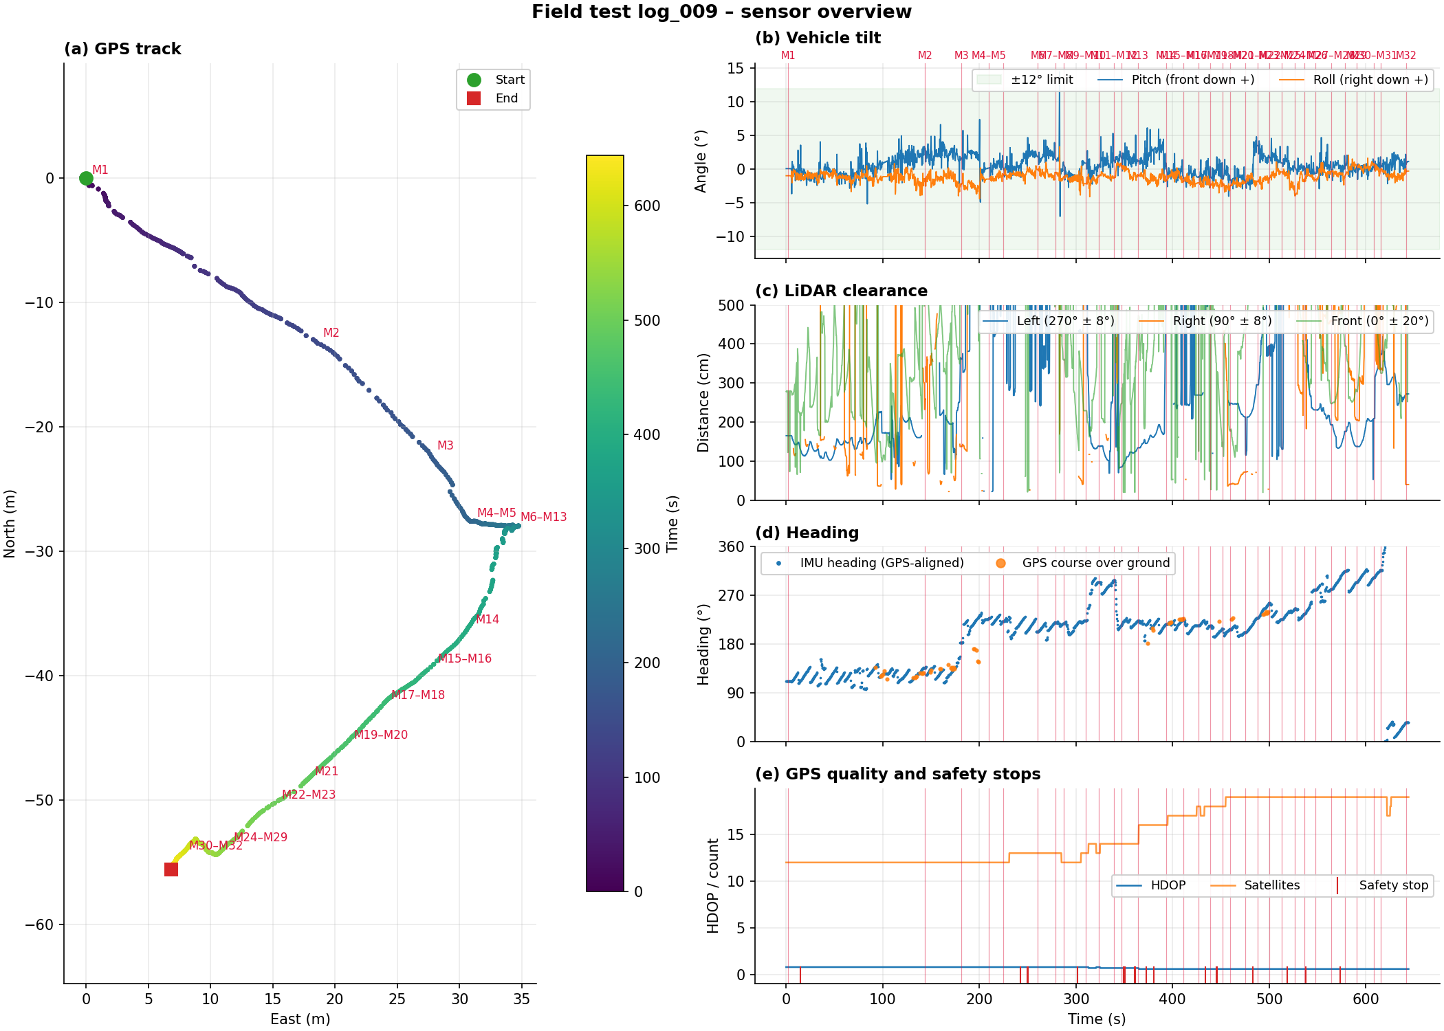
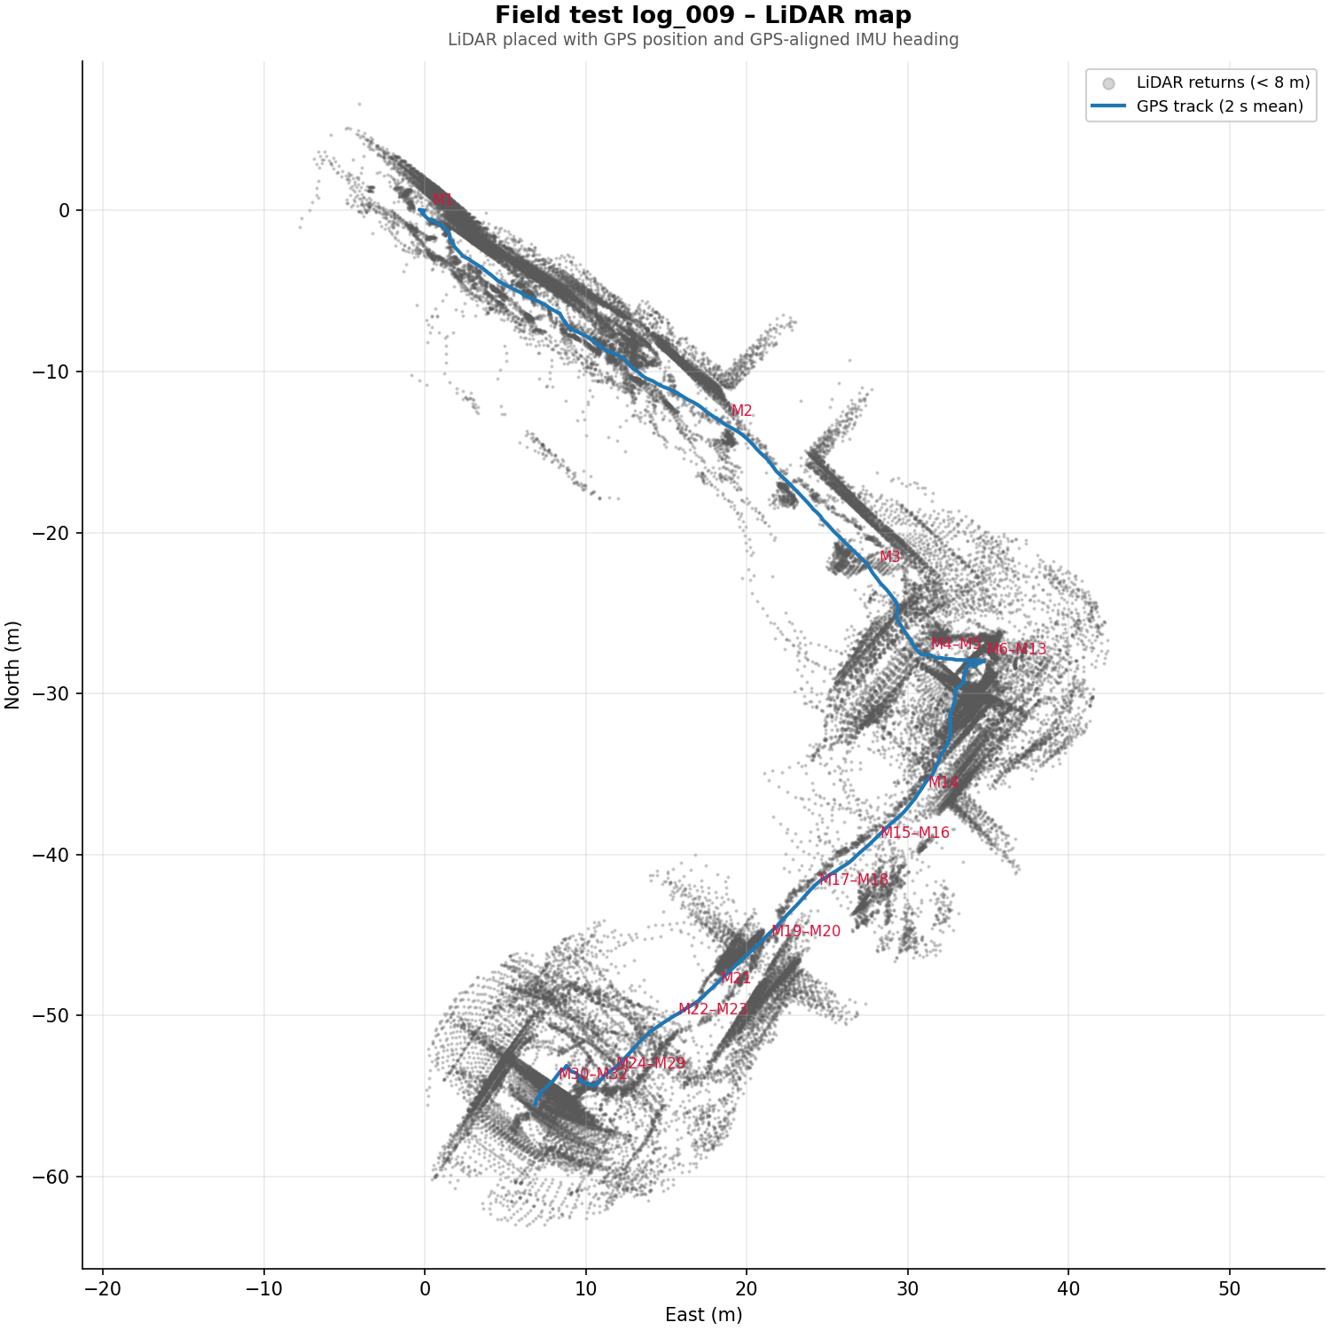
One clean pass B → H in 640 s
LOG_009 · DATA
Left wall ~1.5 m for the first ~140 s (B facade); HDOP ≈ 0.8 throughout
Marks M4–M12 pile up at the ramp corner near D
3 · log_009
Notes:
Tilt stays inside ±12° except one spike of about 15° near 285 s, at the corner. Satellites rose from 12 to 19 during the run. The heading step at about 180 s happens while the GPS track runs straight, so it is a re-reference, not a turn. The LiDAR walls along the B facade are sharp, which means position and heading agreed there.

Slide 4
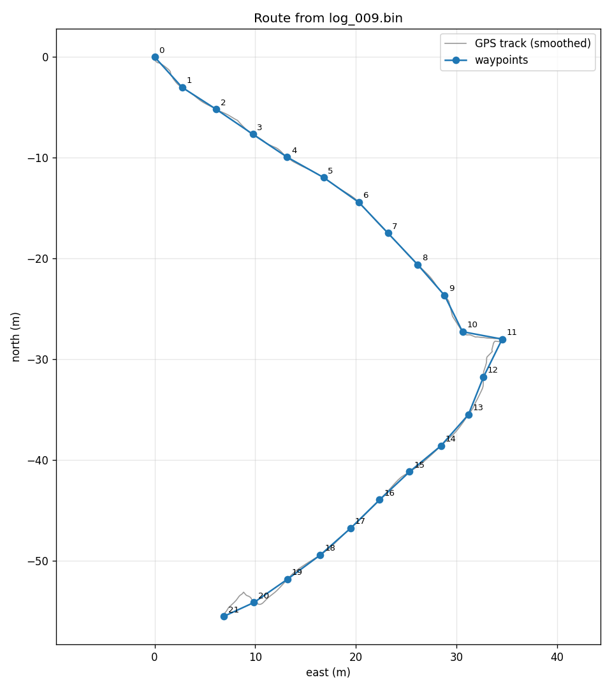
22 waypoints, one every 4 m
LOG_009 · ROUTE
Waypoints follow the smoothed track closely on all straight sections
WP11 sticks out east at the ramp corner: the manoeuvring overshoot, not an ideal line
Small zig-zag at WP19–21: manoeuvring on arrival at H
Facade leg WP0–WP5: 21 m with only 0.24 m sideways spread, heading 125°
4 · log_009
Notes:
The waypoints were made with make_route.py: real 1 Hz GPS fixes only, a 5-fix moving average against GPS jitter, then one point every 4 metres along the track. WP11 is a candidate to delete.

Slide 5
Mission: follow wall B with LiDAR, then GPS waypoints to H
LOG_010 · APPROACH & OUTCOME
~20 m
of B facade followed autonomously, course 125–130°
Problem | Evidence in the log
1 · Weak steering | Wall distance grew 1.3 → 2.4 m; wheel difference ≤0.15 gave only 0–6 °/s of turn
2 · Stuck in AVOID | Obstacle 65–100 cm ahead at facade end; command −0.10 / +0.50 gave no rotation for 25 s
3 · GPS legs off | After WP06 the track ran 6–15 m away from the log_009 waypoints
5 · log_010
Notes:
Also: the leg switch never happened, because the wall stayed visible at 2.4 m. The switch was tied only to the wall disappearing. The manual takeover at 92 to 118 seconds was caused by the AVOID manoeuvre, which was neither a real pivot nor a real arc.

Slide 6
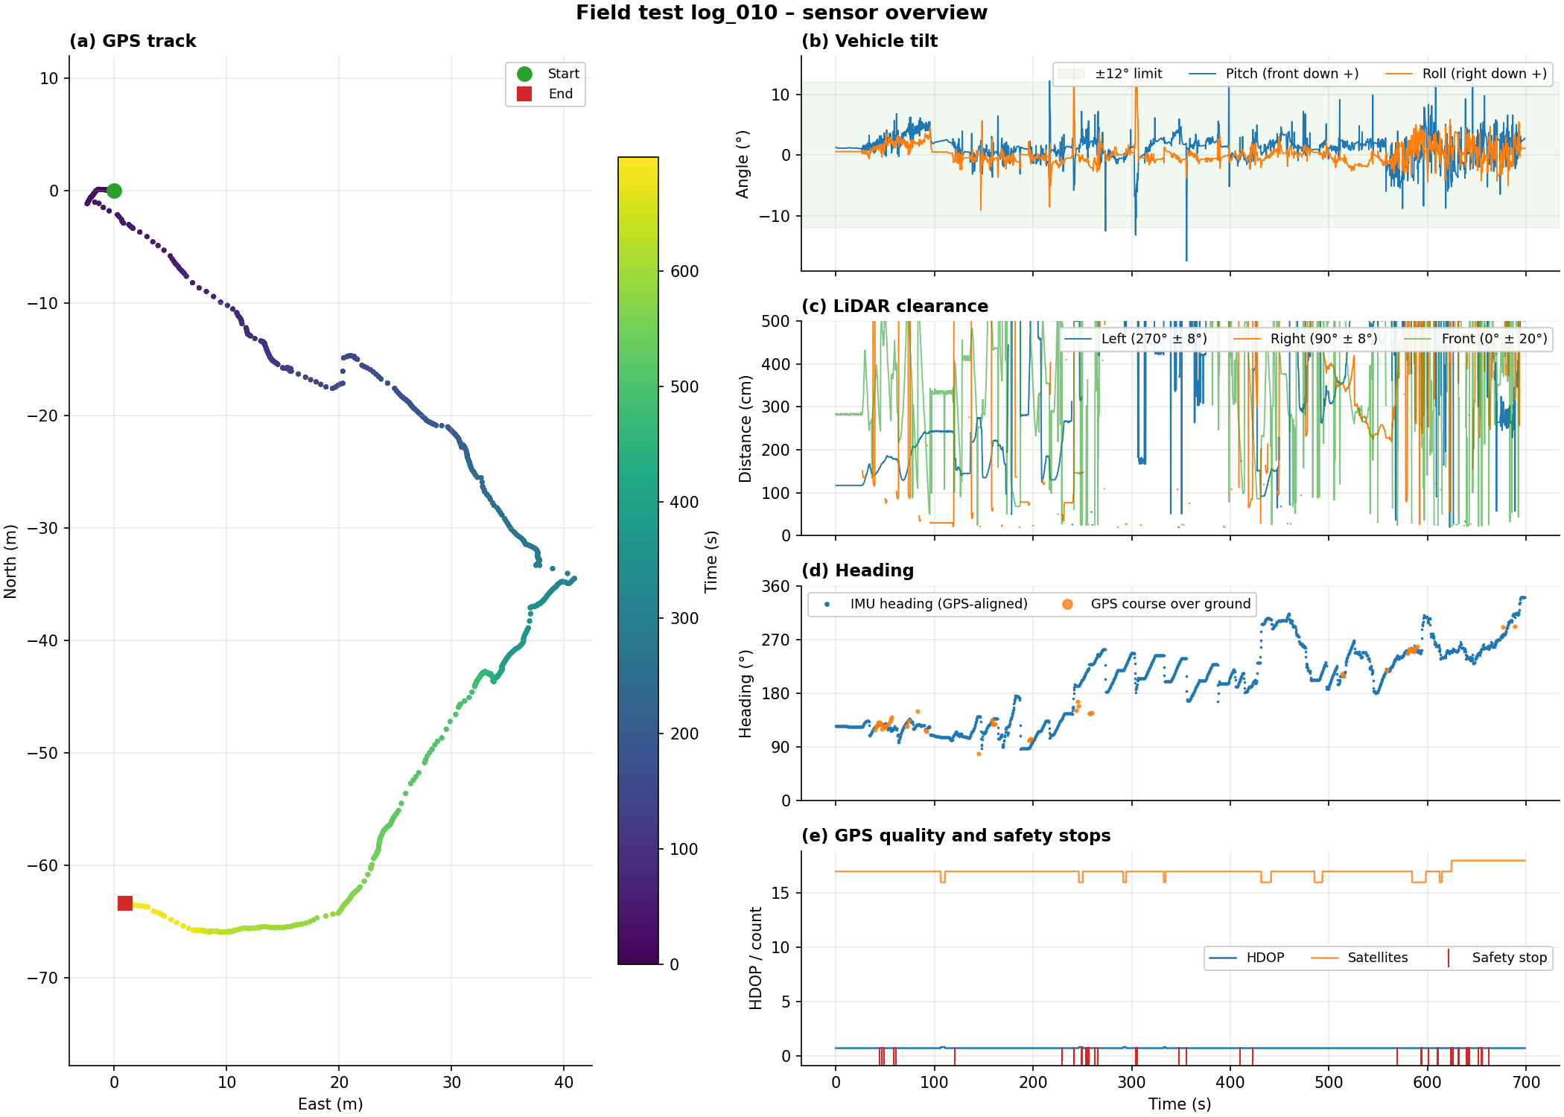
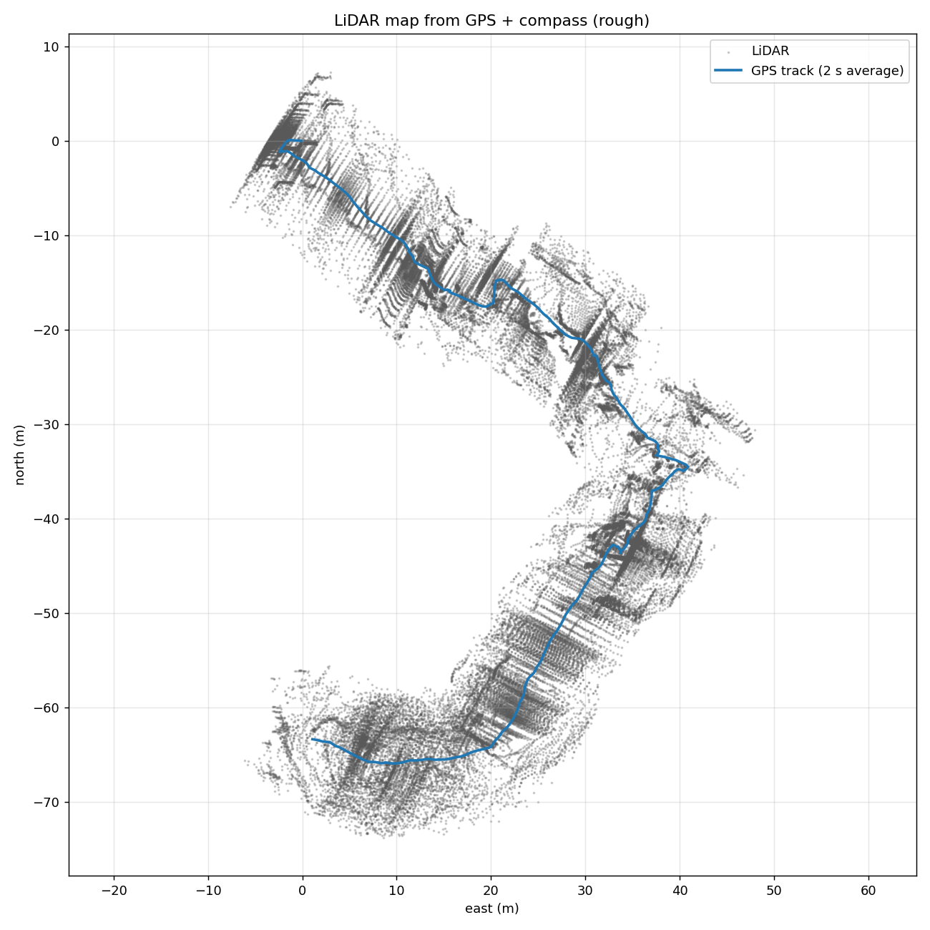
Excellent GPS quality, wrong positions
LOG_010 · DATA
17 satellites, HDOP < 1 – yet 6–15 m off; safety stops cluster at 600–660 s
6 · log_010
Notes:
Good HDOP only means good satellite geometry; it says nothing about absolute accuracy between days. Roll spikes of about ±15° near 240 and 300 s are kerbs or ramp edges. The left wall distance grows during the first 100 s, matching the weak steering on the wall leg.

Slide 7
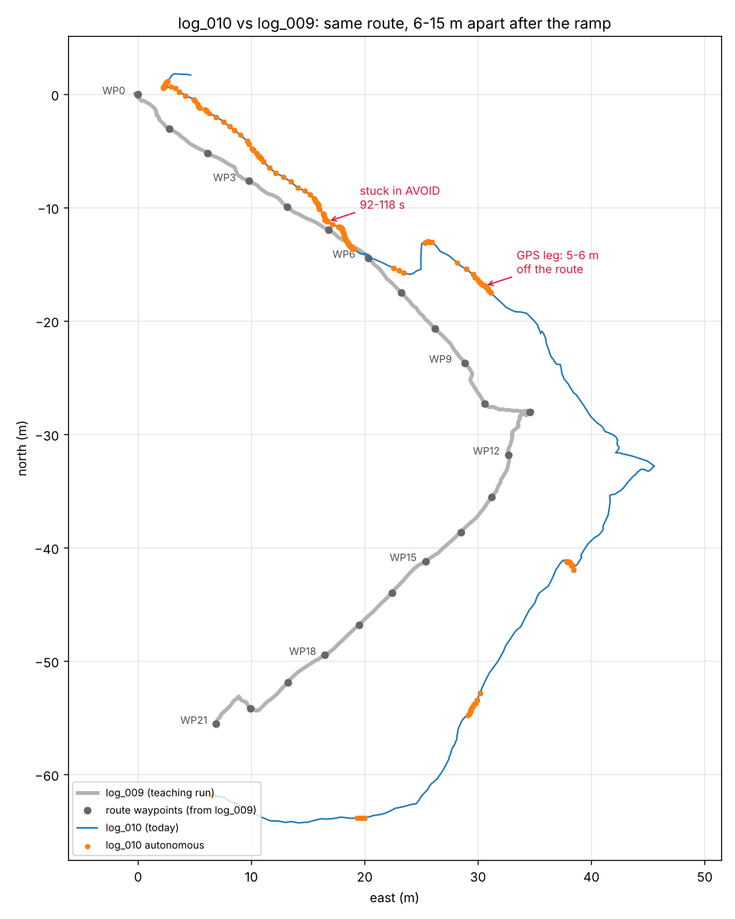
Same path, 6–15 m apart after the ramp
LOG_010 · VS LOG_009
Up to WP06 the two tracks lie within 0–3 m
After the ramp the GPS frame shifted: the waypoints from the same day were 6–15 m away
Stuck at 92–118 s near the B facade end
Autonomous stretches (orange) after WP06 are short: each GPS leg aimed at a point that was not there
7 · log_009 vs log_010
Notes:
Grey is the log_009 teaching run with its waypoints, blue is log_010, orange dots are moments the box drove on its own. This plot is the main evidence for moving GPS to a zone check only.

Slide 8
Lessons and Next Steps
SUMMARY
A clean manual run is the benchmark and test set
GPS shifts up to 15 m between days: (Will be ruled out in future)
LiDAR + gyro carry localisation; walls re-anchor heading
Measure the vehicle first: the controller must match what the chassis can do
Planned to have replay logs in a simulator before every flash
8 · Summary
Notes:
The route logic is close; the remaining work is steering on real hardware. The tap controller and the new rover are the two things that decide the next test.

